Slide 1
Python programming
unit 4A – error handling

Slide 2
Expected problems
Like: user entered invalid data, a file from internet needs to be checked before using:
Using all the checking and validation to avoid any problems and security threats in this case
Check if input data is valid digits, valid numbers
Check if the input string has special characters like ‘,’ or ‘;’
Check if the input string has special characters like ‘”’
......

Slide 3
Error / exception in python
Syntax error:
when parsing the program code python cannot understand it. Must be corrected before program can fully run.
Run time problem: even syntax all correct, still can meet problem during program running
Error
Exception
Python has many build-in defined errors, like: division by zero, name error, type error, memory error, etc.
Can subclass from existing error class, or exception class, to customize our own error/exception type
Use raise when need to indicate a problem occurred.
Error handling:
Use try / except / finally to do error handle
Try to guard the code that may have problem
Except to catch one specific error type and handle it. Can have multiple except to catch different error types.
If need to propagate the error, can continue to raise again in except block.

Slide 4
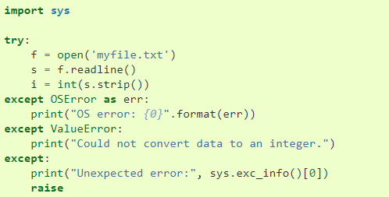
Examples from python docs
A normal error handling
Try to guard the code which may have problems
Except to catch certain type of problems and handle it.
For other problem cannot handle can continue propagate it with the ‘raise’ statement.

Slide 5
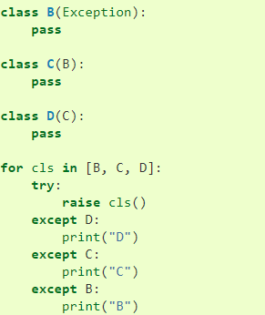
Examples from python docs
Customized exception class, sub-class from python build-in Exception class
If put except B as the first clause, then all error will be caught by that, because C and D is also instance of B. So be careful about the inheritance hierarchy.

Slide 6
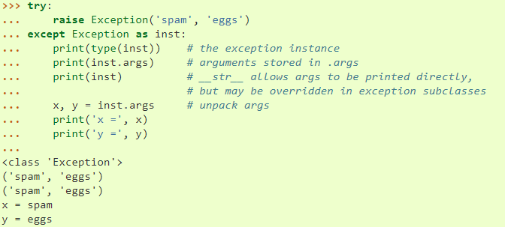
Examples from python docs
Customized exception can have args passed, which can provide more detail information regarding the problem happened.

Slide 7
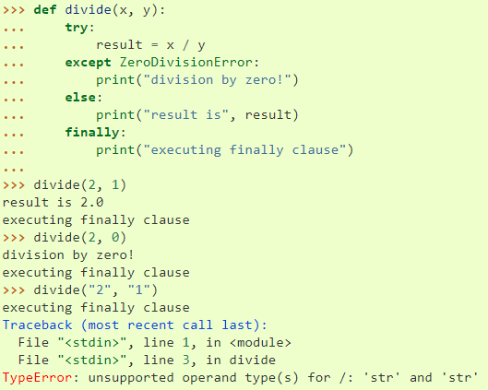
Examples from python docs
Else only when nothing wrong happen get executed.
Those problem not caught, will be continue raised automatically after finally get executed.

